Slide 1
Secure DATA HIDING IN Image using steganography
CAPSTONE PROJECT
Presented By:
Student Name : Atibali Minhajali Saiyed
College Name & Department : CSPIT, Charusat

Slide 2
OUTLINE
Problem Statement
Technology used
Wow factor
End users
Result
Conclusion
Git-hub Link
Future scope

Slide 3
Problem Statement
The Steganography project focuses on securely hiding and retrieving secret messages within image files using encryption techniques. The project implements a method to encode text messages into pixel values and later decrypt them using a passcode. XOR encryption is applied for added security, ensuring only authorized users can access the hidden information. The system provides a simple yet effectivee.

Slide 4
Technology used
Programming Language: Python
Platform: VS CODE
Libraries Used:
OpenCV (cv2): For image processing (reading, modifying, and saving images)
NumPy: For handling image data and performing encryption operations
OS: For file handling and system operations

Slide 5
Wow factors
1. Password-Protected Encryption: The message is encrypted using a user-defined passcode, ensuring only authorized users can decrypt it.
2. XOR-Based Encryption: Unlike traditional LSB (Least Significant Bit) steganography, this project uses XOR encryption with a key derived from the passcode, adding an extra layer of security.
3. Termination Marker for Message Extraction: The project includes a unique termination marker (`~`), making message retrieval accurate without unnecessary extraction.
4. Efficient Image Modification: Instead of modifying only LSBs, the project applies encryption across the image pixels, reducing detectability.
5. Cross-Platform Adaptability: Though developed on Windows, the project can be easily modified to run on Linux and macOS.
6. Real-Time Image Preview: The encrypted image is automatically displayed after encoding, allowing users to verify modifications.

Slide 6
End users
1. Cybersecurity Enthusiasts & Ethical Hackers – Professionals and learners in cybersecurity can use this tool to understand and implement secure communication techniques.
2. Journalists & Whistleblowers – Individuals who need to share sensitive information discreetly without being detected.
3. Government & Defense Organizations – Agencies requiring secure transmission of confidential messages.
4. Forensic Experts – Investigators and forensic analysts can use this tool to embed and extract hidden information for security purposes.
5. Students & Researchers – Those studying cryptography, steganography, and digital forensics can use this as a learning tool.
6. Corporate Organizations – Businesses that need to share private information securely within internal networks.

Slide 7
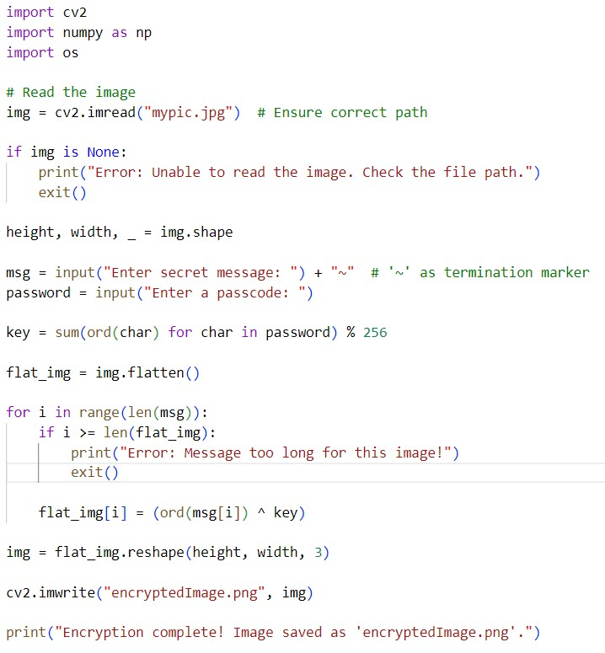
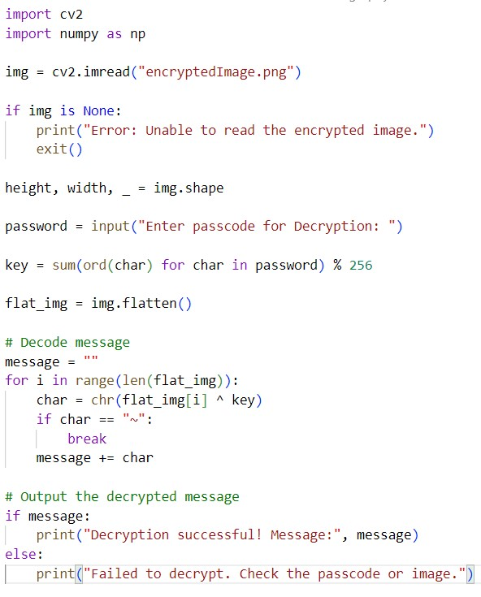


Results

Slide 8
Conclusion
This steganography project ensures secure communication by embedding encrypted messages in images. With password-based protection, it enhances privacy and prevents unauthorized access. The project effectively addresses secure data transmission needs while maintaining image integrity, making it useful for cybersecurity and privacy applications.

Slide 9
GitHub Link
https://github.com/Atibali/Steganography.git

Slide 10
Future scope(optional)
Advanced Encryption – Integrate stronger encryption algorithms for enhanced security.
Multi-Format Support – Extend support to audio and video steganography.
AI-Powered Detection – Use AI to optimize message embedding without altering image quality.
Cloud Integration – Enable secure cloud-based steganography for remote access.
Real-Time Applications – Implement real-time steganography for secure messaging platforms.

Slide 11
THANK YOU

